Slide 1
Deep Learning
DL CognitRonS

Slide 2
Fruits Classification
By-
Ashish Tiwari
Swaroop Devaraju

Slide 3
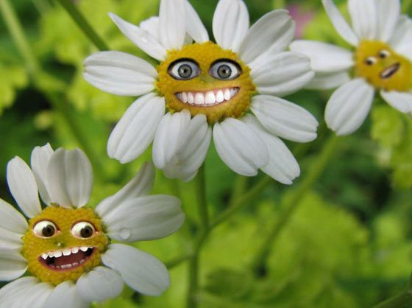
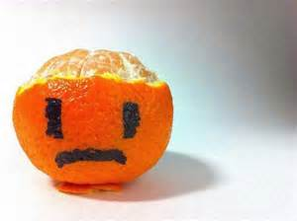

Why Fruits???

Slide 4
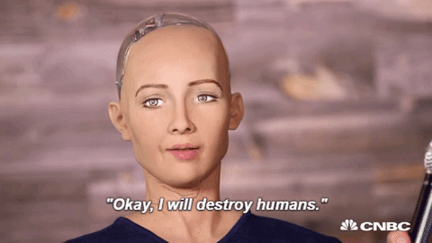
And This!!!!!

Slide 5
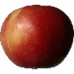
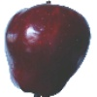
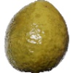
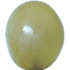
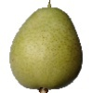
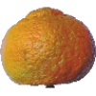
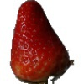
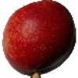
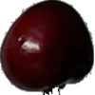

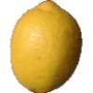
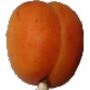
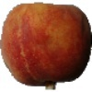
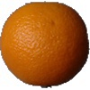
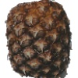
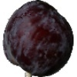
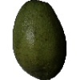
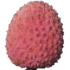
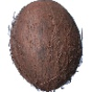
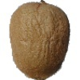
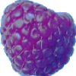
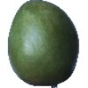
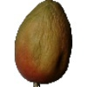
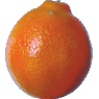
So Let us first talk about image data

Slide 6
Image Dataaaaaaaa!!!!!!!!!!!
Total Number of Images: 38409
Training set size: 28736 images.
Validation set size: 9673 images.
Number of classes: 60 (fruits).
Image size: 100x100 pixels.

Slide 7
Convolution Neural Networks
First Model

Slide 8
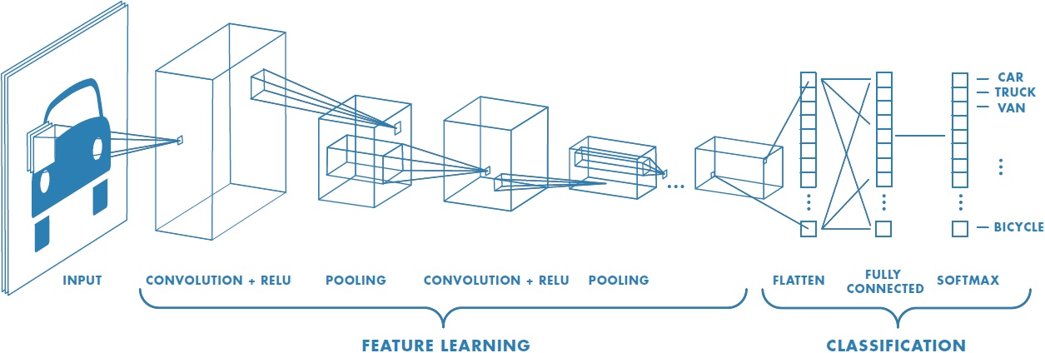
Convolution Neural Networks

Slide 9
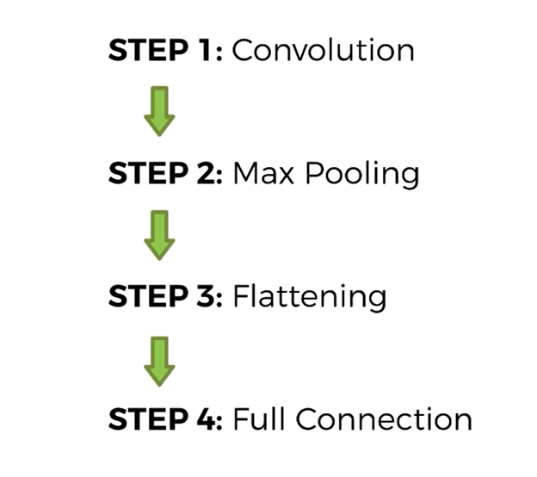
What is this?? We all know!!!!
A CNN is comprised of one or more convolutional layers and then followed by one or more fully connected layers as in a standard multilayer neural network
Convolution
Pooling
Fully Connected
Weights

Slide 10
What we did???
We applied convolutional neural network on the image data set with three convolutional layers
First layer -> convolutional layer 5 x 5 x 3 -> 32 outputs
Max pooling -> 2 x 2 filter with stride 2
Second layer -> convolution layer 5 x 5 x 128 -> 64 outputs
Fully connected layer with 64 inputs and 32 outputs and so on
This is in turn fed to the activation function, SoftMax
SoftMax loss layer has 32 inputs and the output is equal to the number of classes

Slide 11

K K K K K Keras
Keras is a high-level neural networks API, written in Python and capable of running on top of TensorFlow, CNTK, or Theano.
We used TensorFlow on backend.
Allows for easy and fast prototyping.
Supports both convolutional networks and recurrent networks, as well as combinations of the two.
Runs seamlessly on CPU and GPU.

Slide 12
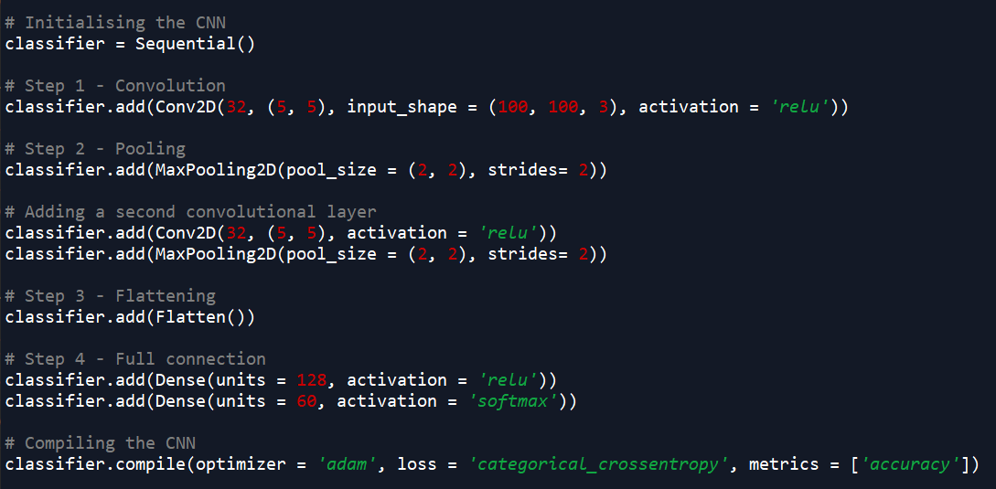
Initial Model

Slide 13
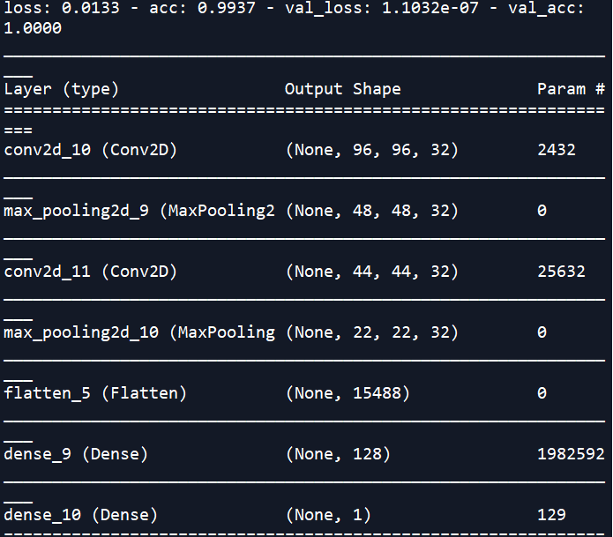
Loss, Accuracy and Model

Slide 14
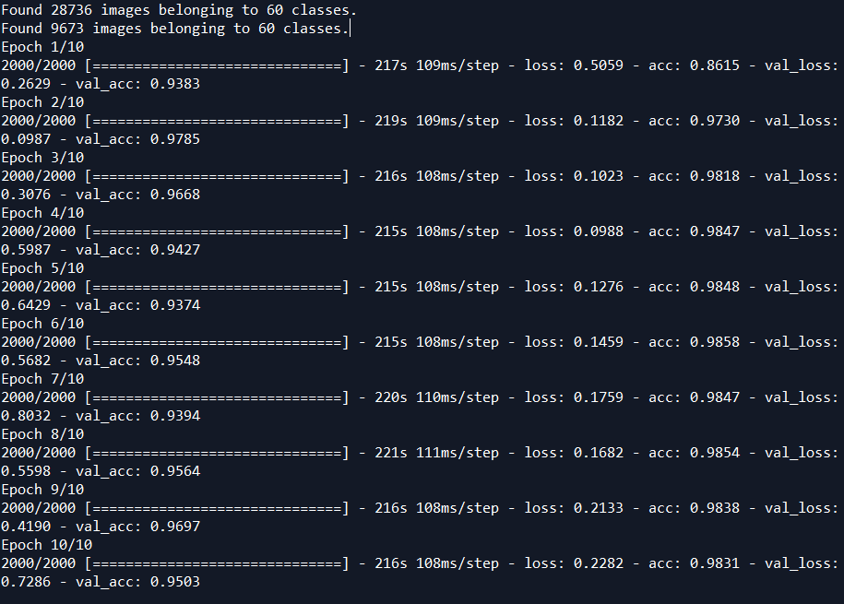

Slide 15
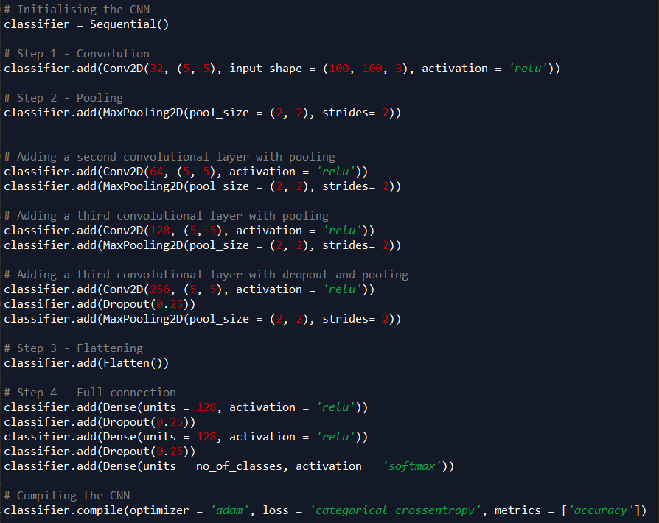
Final Model

Slide 16
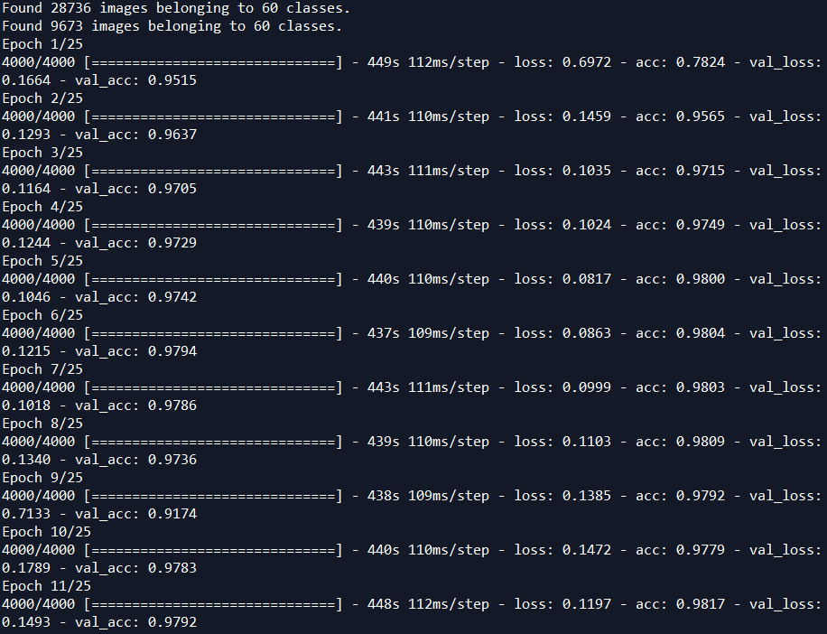
Training Our Model

Slide 17
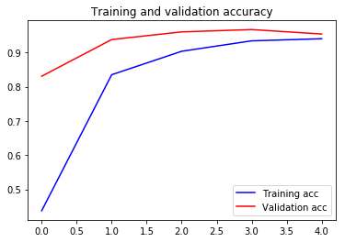
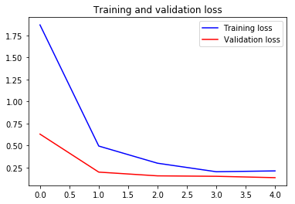
Training and Validation

Slide 18
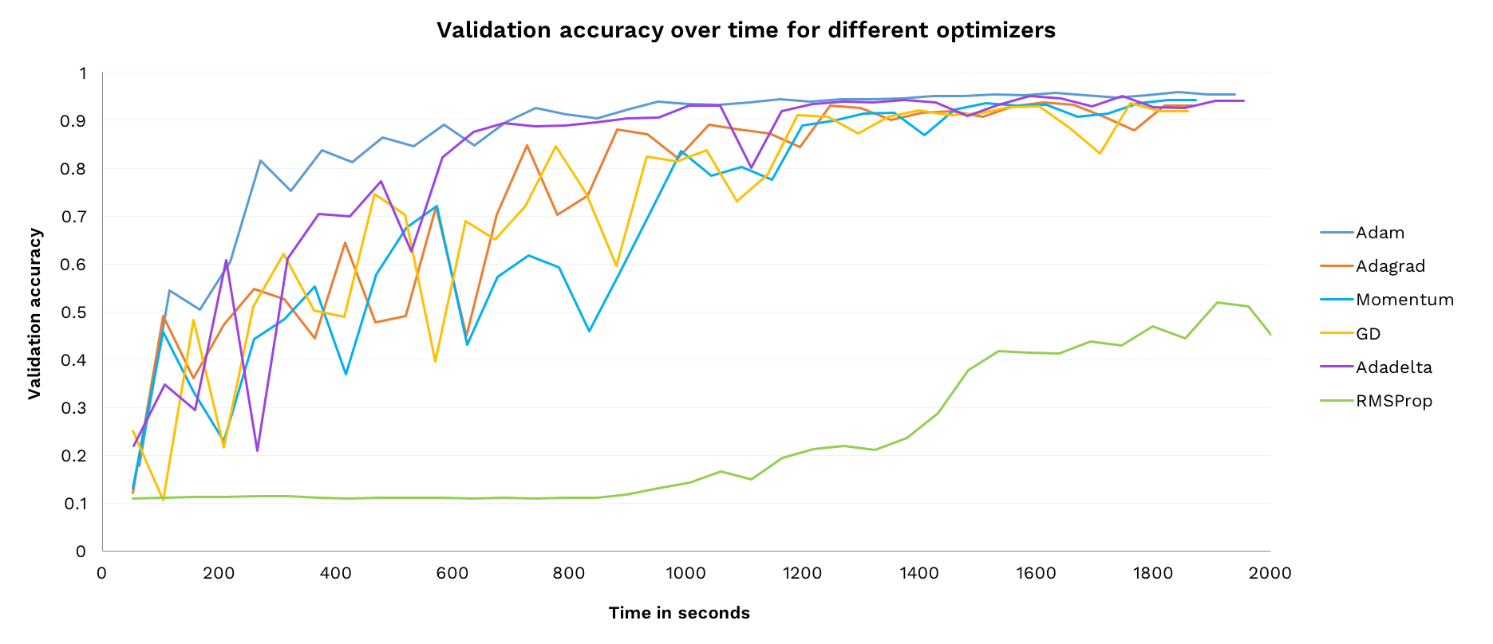
Optimizer Comparison

Slide 19
Deep Residual Network
Second Model

Slide 20
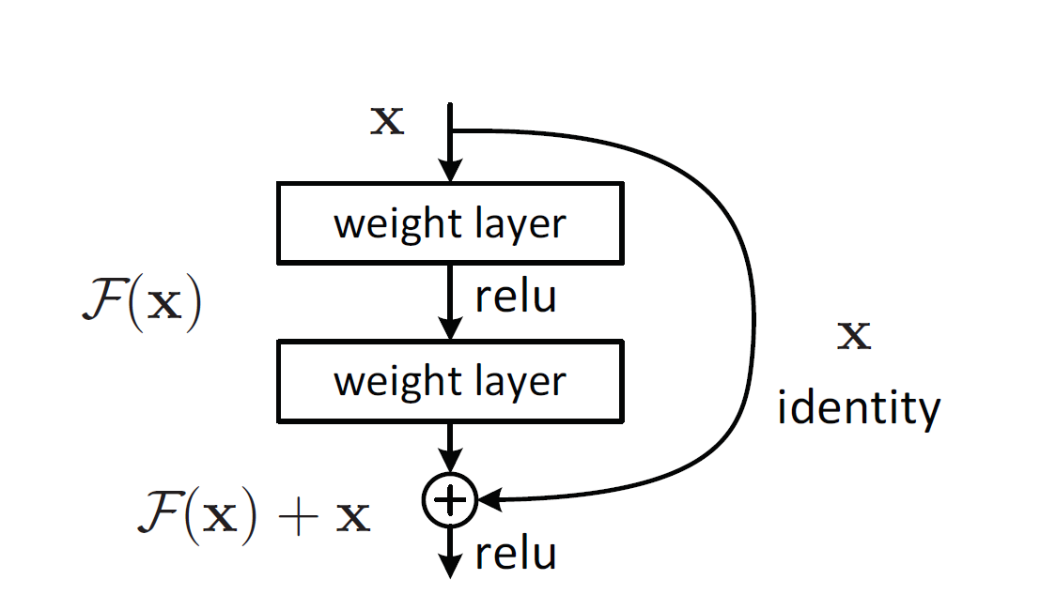
What is Deep Residual Learning

Slide 21
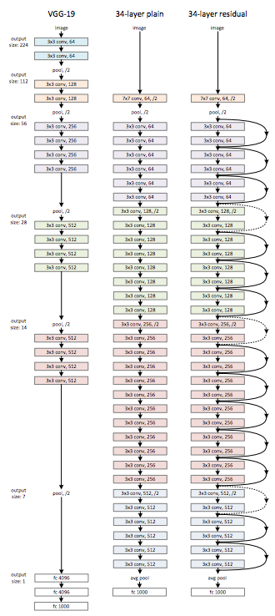
Why Deep Residual Learning??
Developed by researchers from Microsoft Research
One way to ensure this new (N+1)th layer learns something new about your network is to also provide the input(x) without any transformation to the output of the (N+1)th layer.
New layer learns something different from what the input has already encoded.

Slide 22
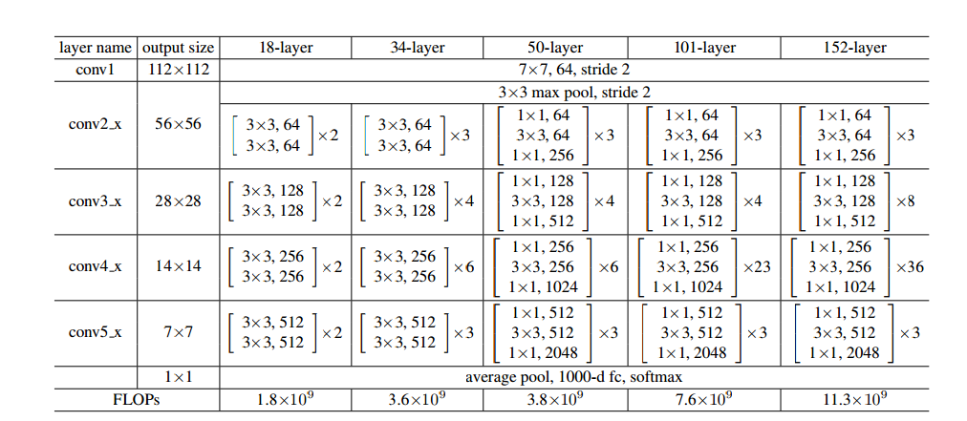
ResNet Architecture

Slide 23
Deploying Deep Learning Model
We Are still working

Slide 24
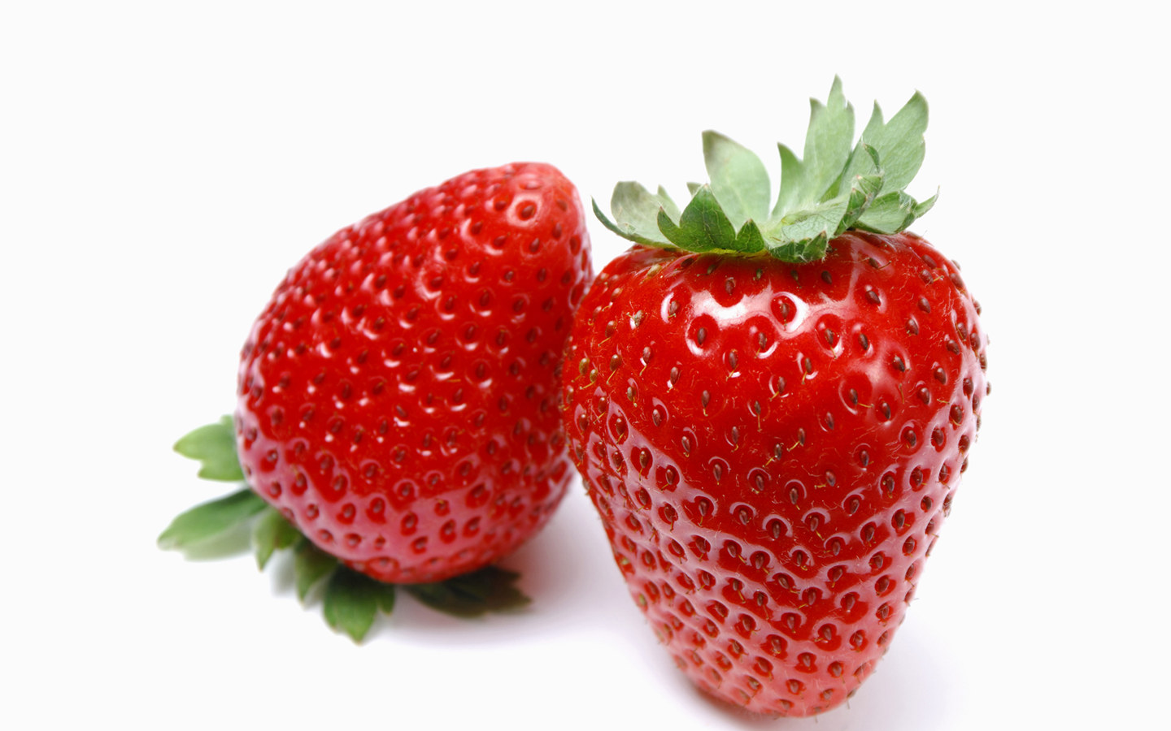
So What We have??
Images
Model

Slide 25
What we have to do?
Install OpenCV to make our web cam as our source.
Read image from the video using OpenCV.
Process it to Keras format.
Predict the image and display the label.

Slide 26
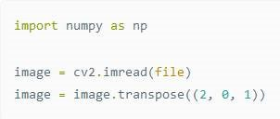
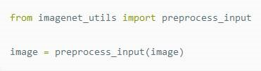
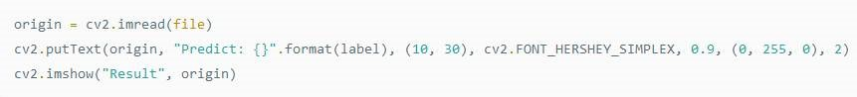
Code to Convert image read from OpenCV to Keras format and Read the image from a file and attach a label

Slide 27
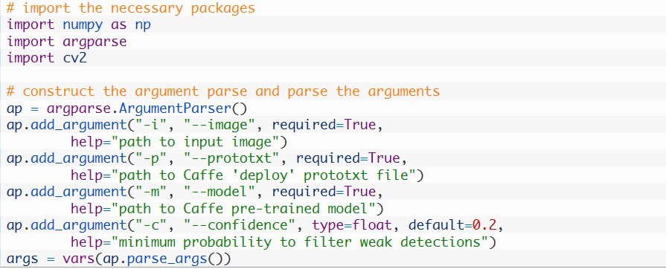
Snippet

Slide 28
Demo Time
Fun Part

Slide 29

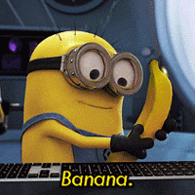
This guy is going to test our MODEL!!!!!

Slide 30
So Lets Go for it
Thank you

